Slide 1
Building for the Future with Windows Phone & Windows 8
Danny Warren
@dannydwarren

Slide 2
What is WinRT?
New Framework - Not .NET
Lives in its own sandbox
From a dev. standpoint this is what Windows reimagined means!

Slide 3
What’s Awesome About WinRT
Multilanguage Support
App-to-App Communication
Async! Async! Async!

Slide 4
Where Does WinRT Run?
Windows 8
Windows Phone 8
XBOX (Future)
All Next Generation Windows Devices

Slide 5
WHY?!?
Why should we care?
Why will John Doe care?
Why is…shhh! Ballmer is listening…
…
OK! Why is this a big deal?
Will WinRT Apps run on any of the devices off the shelf?
Can it cure cancer, turn back time, and save my runaway dog at the same time?

Slide 6
Are There Differences Between The WinRT Targets?
Windows 8
Windows Phone 8
XBOX (Future)
All Next Generation Windows Devices

Slide 7
Comparison
Windows 8 - WinRT
Windows Phone 8 - WinRT
Resolutions
Min: 1024x768
Max: NONE!
Full WinRT API aaaaaaaaaaaaaaaaaaaaaaaaa
Used in desktops and tablets
Resolutions
Old: 480x800
New: 768x1280 or 720x1280
Subset of WinRT API + New Phone Only features
Used in phones

Slide 8
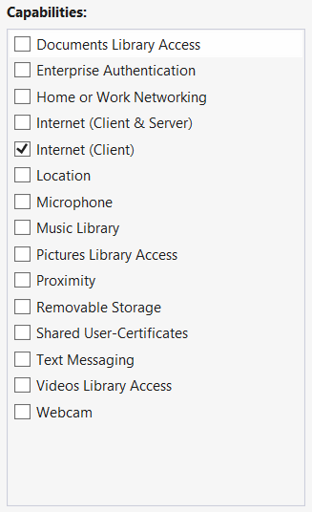
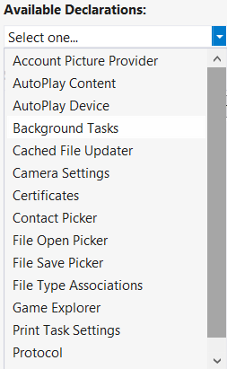

WinRT Capabilities and Declarations

Slide 9
CODE! HALLELUJIA!!!
Search, Sharing Source, and Sharing Target Samples

Slide 10
Conclusion
WinRT ROCKS!
Write once, run anywhere is not quite right, but close!
vNext is Awesome!

Slide 11
LINKS!!!
Win8-WinRT Resolution Info
http://blogs.msdn.com/b/b8/archive/2012/03/21/scaling-to-different-screens.aspx
WP8-WinRT Resolution Info
http://www.winsupersite.com/article/windows-phone-8/windows-phone-8-notes-sdk-143827
Win8-WinRT APIs vs WP8-WinRT APIs
http://www.wpcentral.com/windows-phone-8-sdk-preview-release-leaks-online
Search Contract Tutorial
http://www.silverlightshow.net/items/Windows-8-and-the-future-of-XAML-Part-4-Contracts-in-WinRT-Windows-8.aspx
Share Contract Tutorial
http://www.silverlightshow.net/items/Windows-8-and-the-future-of-XAML-Part-5-More-contracts-in-WinRT-Windows-8.aspx
Migrating from .NET to WinRT
http://msdn.microsoft.com/en-us/library/windows/apps/br230302(v=vs.110).aspx#storage

Slide 12

End of Line
InterKnowlogist – Software Engineer
Danny Warren
@dannydwarren
dwarren@interknowlogy.com
Credentials
Neumont University (http://www.neumont.edu/) Bachelors in C.S.
www.interknowlogy.com
blogs.interknowlogy.com/author/dannywarren/

